Slide 1
An Analysis of Acceptance Policies For Blockchain Transactions
Notes:
This talk is my PhD thesis work at MIT. Eytan Modiano is my advisor.

Slide 2

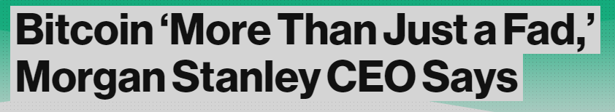
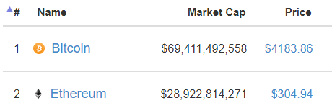
Bitcoin's Rising Popularity
Digital cash
security is paramount
Hundreds of other blockchains (Ethereum, Bitcoin Cash, …)

Slide 3
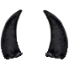




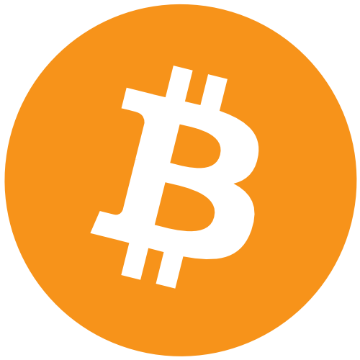

Transaction Finality In Bitcoin
Extremely difficulty to reverse a transaction after ~60 minutes
Consider a method to reduce settlement time

Slide 4
Outline
Introduction and Motivation
Bitcoin Acceptance Policies
Double spending
Current acceptance policies
Analysis of new policies
Notes:
We now discuss randomly located failures (instead of worst-case).

Slide 5
Double Spending Attack in Bitcoin
A transaction spends a certain coin and a subsequent transaction spends the same coin
attacker sends second transaction to himself
second transaction becomes valid

Slide 6

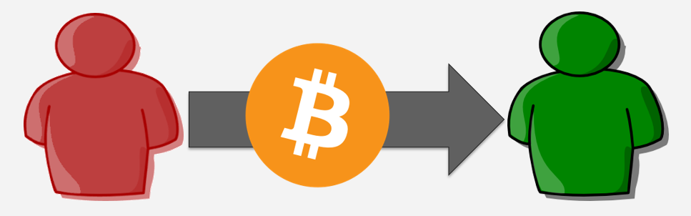
Blockchains serialize monetary transactions
A block contains several thousand transactions
Transaction output must be no more than output
Each block points to one previous block
forms a chain of blocks
Complete ledger can be reconstructed
Block #487211
Block #487212
Block #487213
Block #487214
transaction data
transaction data
transaction data
transaction data
transaction data
transaction data
transaction data
transaction data
transaction data
transaction data
transaction data
nonce
nonce
nonce
nonce

Slide 7
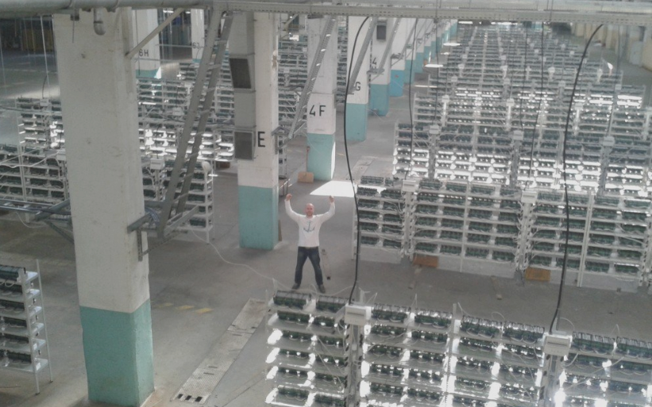
Making blocks is extremely difficult
The finder of each block is rewarded ~$70,000
One block found about every ten minutes globally
7 Exahashes per second

Slide 8
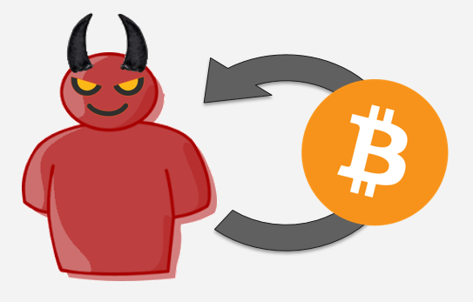
Longest Chain Considered Valid
Allows agreement the ledger
Attacker may decide to mine in secret
With luck, he can form a chain longer that the public main chain
Includes double spending transaction
transaction data
transaction data
transaction data
transaction data
not in ledger
broadcast
and becomes longest chain
transaction data
transaction data
nonce
nonce
secretly created
transaction data
transaction data
transaction data
transaction data
nonce
transaction data
transaction data
transaction data
transaction data
nonce
nonce
nonce

Slide 9
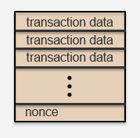
Waiting To Accept A Bitcoin Transaction
Current practice: wait for 5 blocks
about 50 minutes
Protects against double spend attacks
extremely small probability of attacker success
Waits for 5 blocks

Slide 10
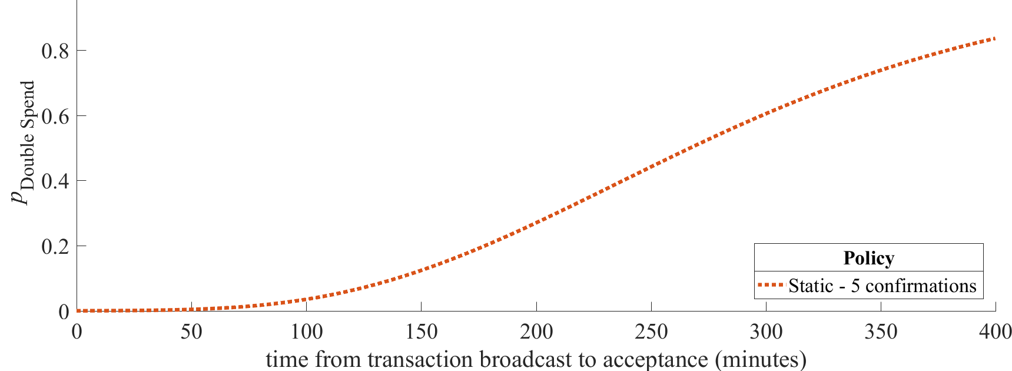


Block Timing Matters
Amount of time for 5 blocks to arrive affects attacker success chance
block #485661 had 5 blocks follow in 9 minutes
block #152217 had 5 blocks follow in 3 hours

Slide 11
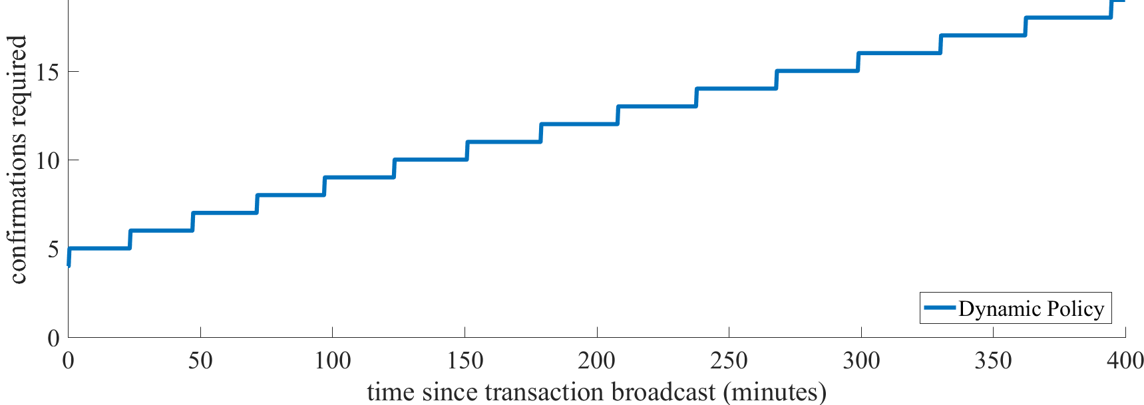
Dynamic Acceptance Policy
Number of blocks to wait for is a function of time since transaction broadcast
does not discard block timing information

Slide 12
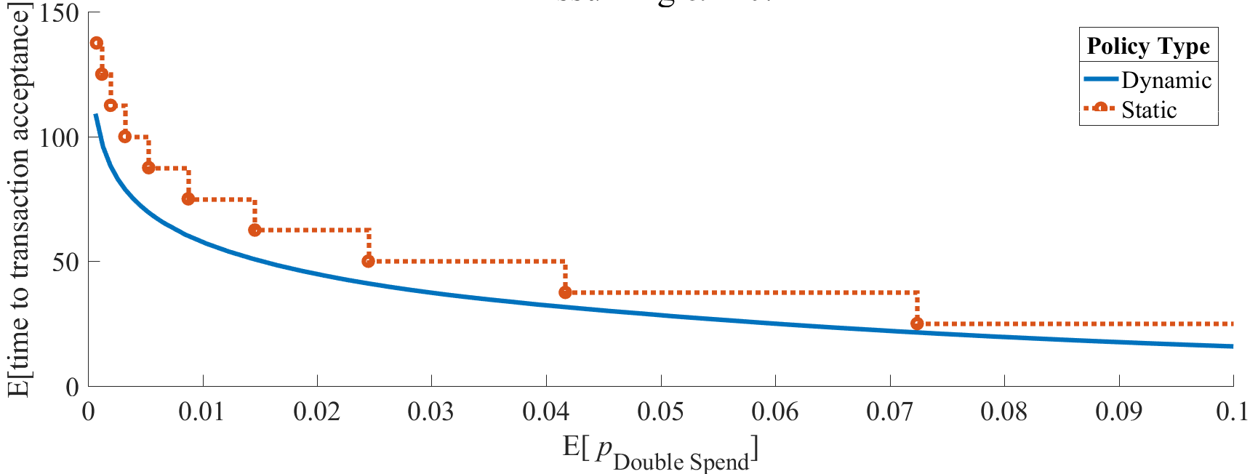
Smaller time waited
Dynamic acceptance policies reduce time waited until settlement for the same level of security

Slide 13
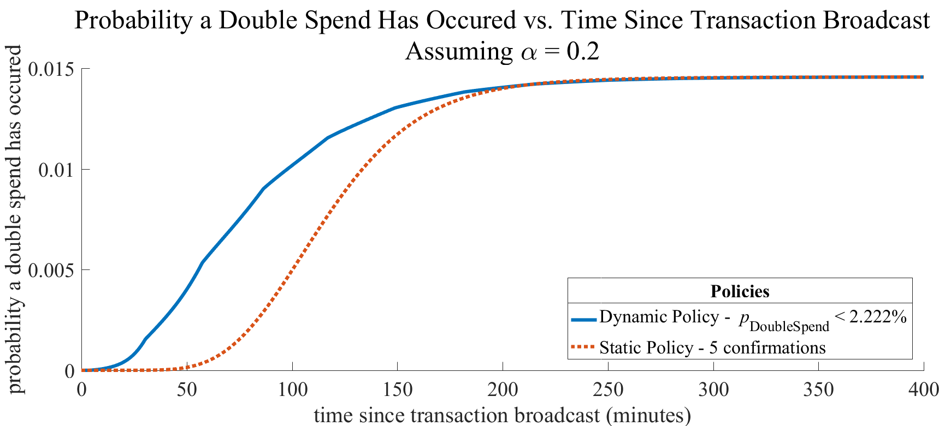
Reduced attacker burden
Dynamic acceptance policies reduce the time until double spend
cost is proportional to time

Slide 14
Future Work
Other families of dynamic acceptance policies
minimize expected acceptance time
maximize cost to perform double spend
Blockchains beyond Bitcoin
greedy heaviest observed subtree in Ethereum

Slide 15
END
END OF SLIDES

Slide 18
transaction data
transaction data
transaction data
nonce

Slide 20

Outline
Introduction and Motivation
Geographic Scale Physical Attacks
Identifying the most vulnerable location
Geographic min-cut and max-flow
Assessing the impact of a random disaster
The BTC Ring
Seriously?
Properties of digital assets
Reactions to information age jewelry
"This has to be a parody right, guys?"
-Lando_Calrissian
"Man, the onion is really stepping up their game"
deleted comment
Notes:
We now discuss randomly located failures (instead of worst-case).

Slide 21
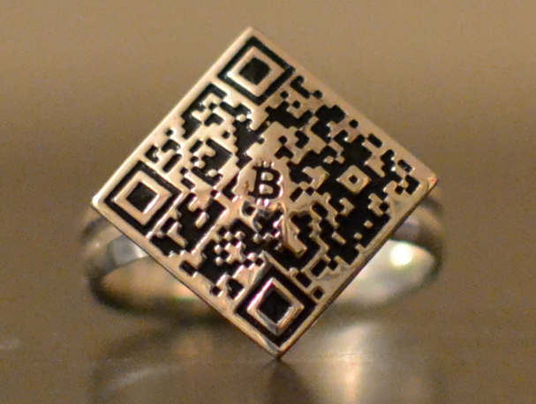
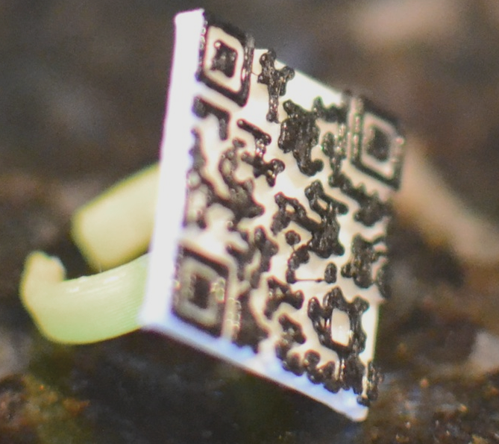
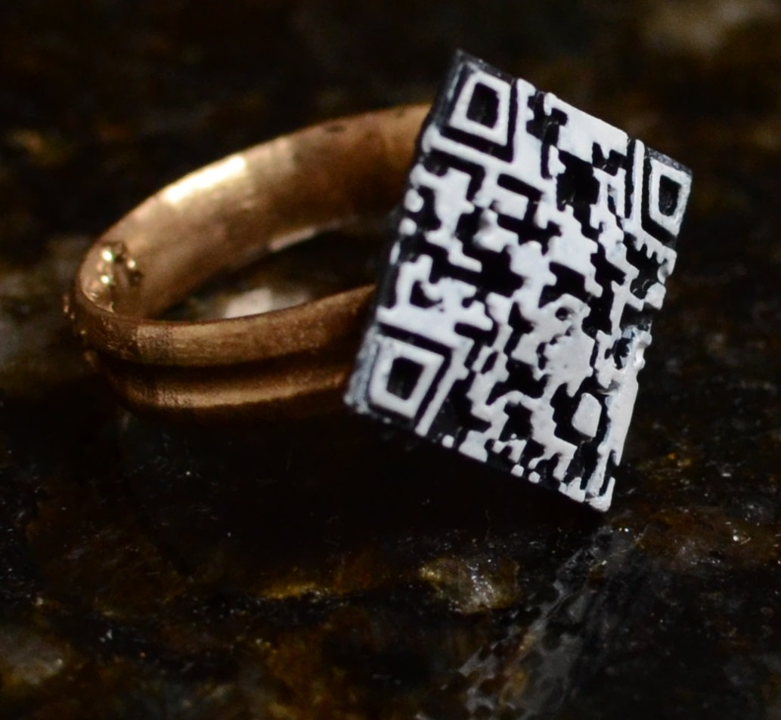
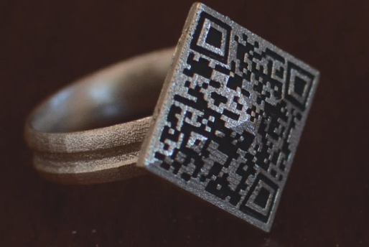
The BTC Ring - Background
Started as a MIT summer hackathon project in July 2014
Team members included Grace Woo, Will Leonard, and John Kelleher
Everything is open-source and made by the user
Not a start-up

Slide 22
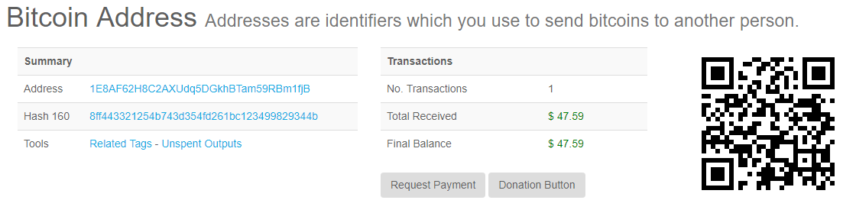
Bitcoin (BTC) Background
Public ledger that everyone in the world sees and agrees on
a Bitcoin address corresponds to a location in the ledger
amount of money at address is public
a long string of numbers and letter sometimes represented as QR code
cryptographic private keys allow access to the Bitcoin
stored so that it is extremely hard for an attacker to access (e.g. safety deposit box or computer at home)

Slide 23
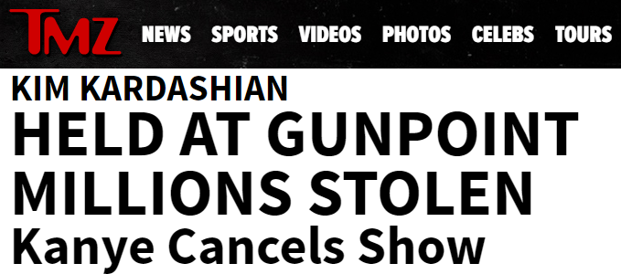
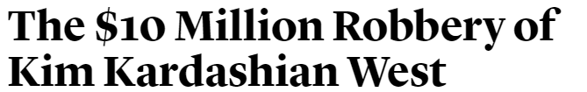
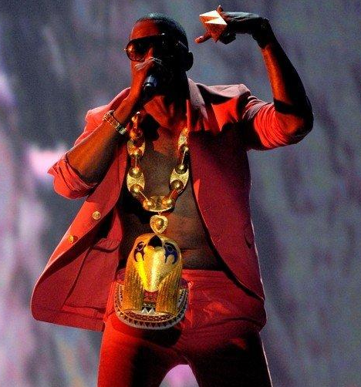
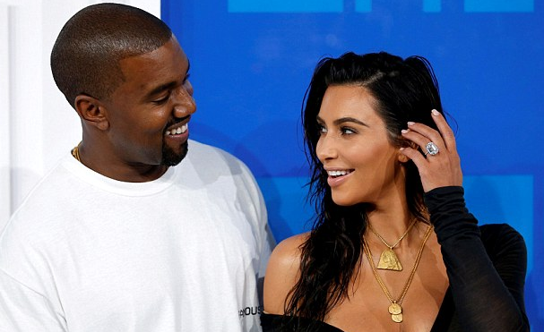
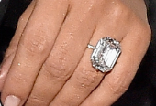
Jewels and Gold Invite Trouble

Slide 24
No Value On The Physical BTC Ring
QR code is a Bitcoin address that points to value
RING DOES NOT DISPLAY THE PRIVATE KEY!
NOTHING OF VALUE ON THE PHYSICAL RING!!!

Slide 25
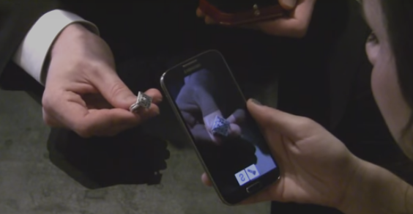
Checking Value On A BTC Ring
App to check the balance of the BTC address at address shown on ring
$133,000

Slide 26
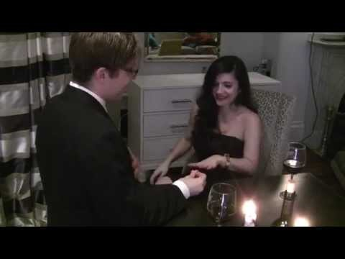
Video Demonstration

Slide 27
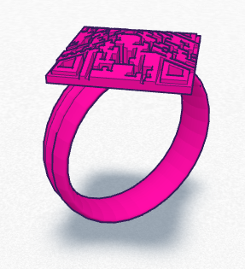
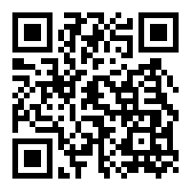
How To Make A BTC Ring
Just put your Bitcoin address on a ring!
Tools at theBTCring.com can help you do this
permissionless and free, just like Bitcoin
User inputs
BTC address
CAD files on
theBTCring.com
3-D Printer
1ringfdFYqftHS5mLbjegwnmsHMvVZr3T

Slide 28

Example: Lost BTC Ring In River
$133,000

Slide 29
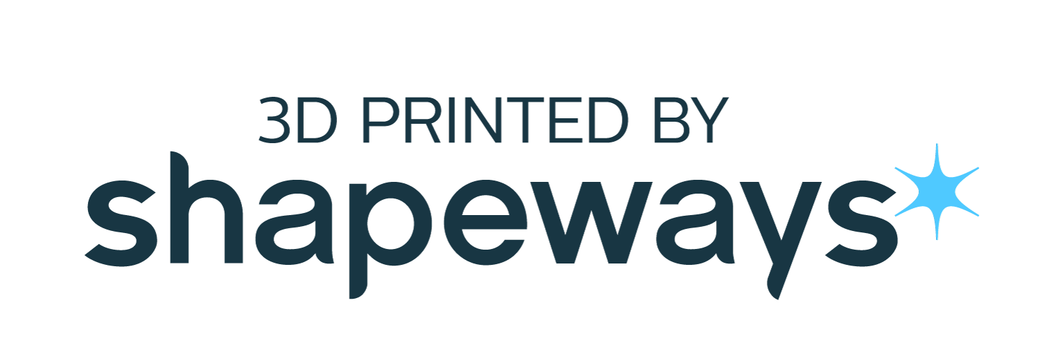
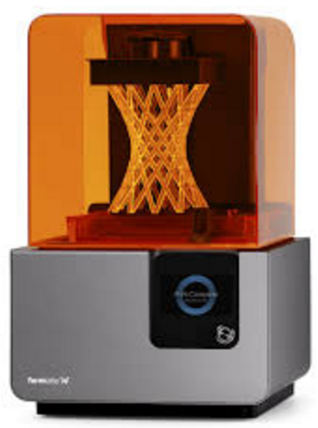
Example: Lost BTC Ring In River
Original CAD file
3-D Printer or Service
$133,000
Total replacement cost < $50

Slide 30
Initial Reactions
The Bitcoin engagement ring is out there. It just might work.
CryptocoinNews
"my gf is into crypto and she said if I load two months salary on the ring she'll wear it. :)"
Kingama on bitcointalk forum
Tweets
wasn't going to bother getting married, now i'm having second thoughts
Maybe it is making a statement about the volatility of love…
I'm so glad that @dbarlon didn't spot http://thebtcring.com/ before now.
Looking for bizarre but inexpensive Bitcoin toys. Current frontrunner: http://thebtcring.com Other ideas equally or more crazy?
This bitcoin engagement ring (with scannable value) is a step in the WRONG direction

Slide 31
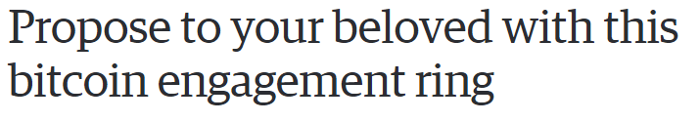

Further Reactions
"Some online commentary of the BTCring project is critical of the idea that you can put a price on love. Others say that only an isolated geek with little understanding of actual human relationships would find it appealing.
But what is most interesting about the BTCring is its reliance on the blockchain to sequester earmarked value, and its use of the blockchain to create a permanent record of a relationship."
-Bill Mauer - Professor of Anthropology and Law, and Dean of Social Science at UC Irvine
Inside the Smithsonian numismatic vault.

Slide 32
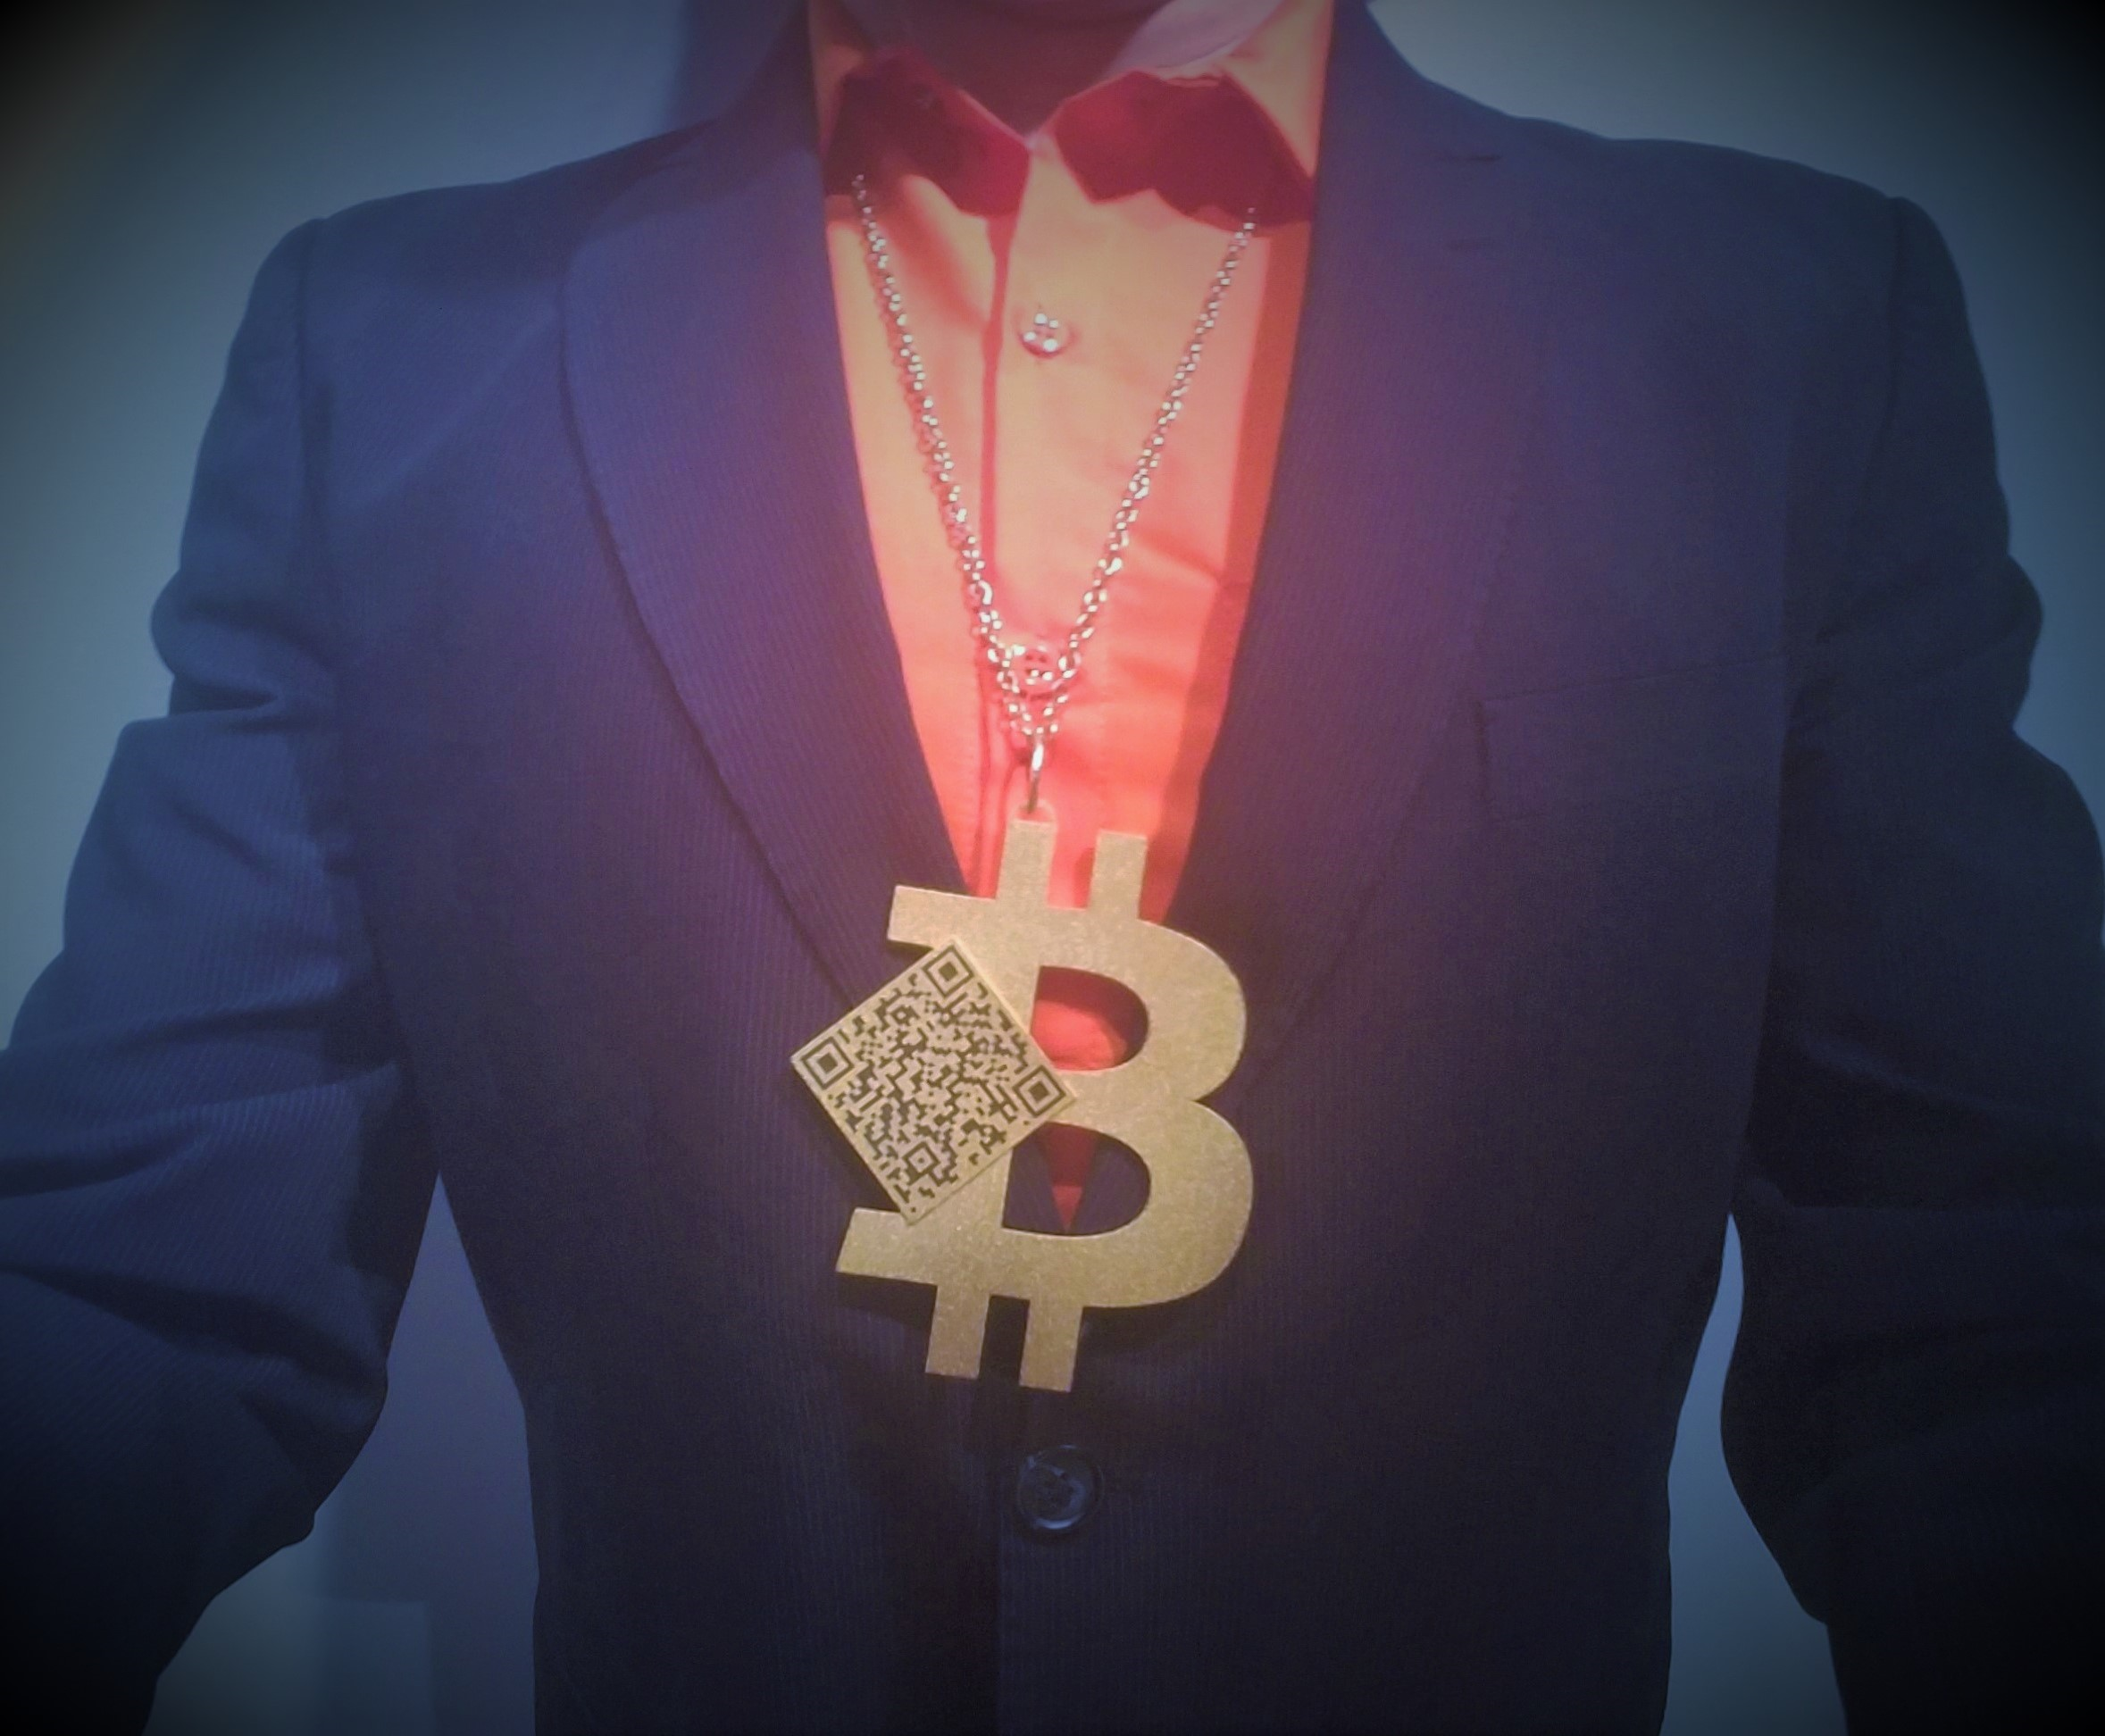
Advantages of BTC Ring
You do not need a jeweler to tell you exactly how much it is worth
The BTC ring can be reprinted to keep up with the latest styles
Decoupled design and value
Bitcoin address can be used in multiple jewelry pieces
Not possible with diamonds or jewels
Value does not lie on ring itself

Slide 33
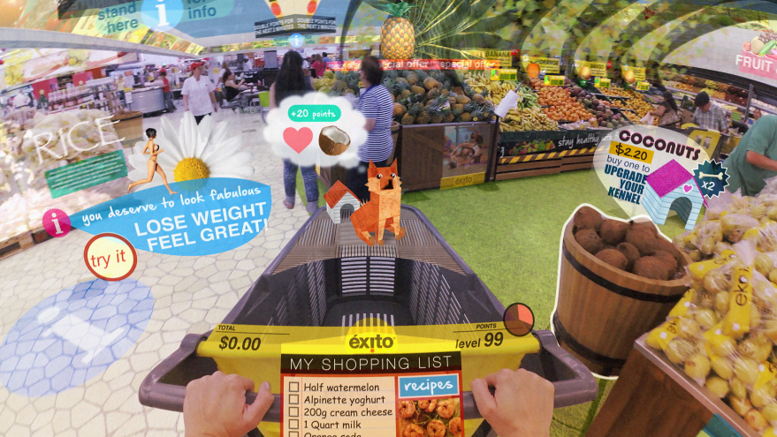
BTC Ring Augmented Reality
$742

Slide 34
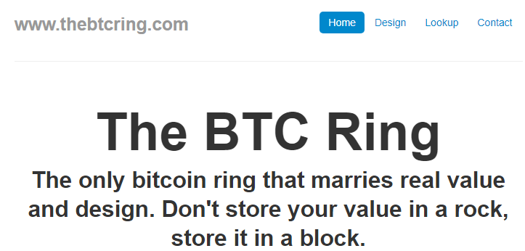
Please visit
theBTCring.com
for more details

